Slide 1
Propositional logic
Logic is a way to represent facts(knowledge) in natural language sentences
Real world facts are represented by logical propositions written as well formed formulas (wff)
New knowledge can be derived from old using mathematical deduction.
We can conclude that a new statement is true by proving that it follows from the statements that are already known.
The idea of proof in mathematcs can be extended to include deduction as way of deriving answers to questions and solutions to problems.

Slide 2
Propositional logic
It is raining
raining
It is sunny
sunny
It is windy
windy
If it is raining then it is not sunny
raining-> ^sunny
If we know that it is raining, then we can also conclude that it is not sunny by following the implication signs.
Also if it is sunny, we can conclude that it is not raining.

Slide 3
Limitations with propositional logic are:
There are no quantifiers and variables
There are no predicates and facts common to a class cannot be represented
e.g men are mortal
can only be represented by separately stating the mortality of every man.
Mortalram, mortalravana....

Slide 4
First Order Predicate Logic(FOPL)
Syntax of FOPL
Constants KingJohn, 2, UofA,...
Predicates Brother, >,...
Functions Sqrt, LeftLegOf,...
Variables x, y, a, b,.
Connectives Λ(and), V(or), Г(not)
Equality =
Quantifiers ∀x (for all), ∃y(there exists)
Implication ->

Slide 5
Predicates:
Predicates are functions returning true or false values.
e.g:
mother(sita, raju)
will be true if sita is mother of raju otherwise false

Slide 6
Prove fido will die - prove die(Fido)
1. All dogs are animal.
∀x: dog(x) -> animal (x)
2. Fido is a dog.
dog(fido)
3. All animals will die.
∀x: animal(x) -> die(x)

Slide 7
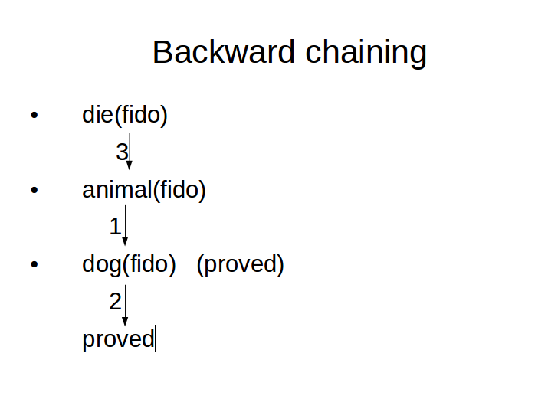
die(fido)
3
animal(fido)
1
dog(fido) (proved)
2
proved

Slide 8
Backward chaining
Start with the predicate to be proved.
Check whether the predicate is available as a fact. Then it is proved.
Otherwise check for a rule with right hand side as this predicate. Try to prove the predicates in the left hand side in a recursive manner. Make suitable substitutions during this step.
Also functions can be computed and replaces with values during the backward chaining.

Slide 9
Forward chaining
Starting from given facts to the goal to be proved.
Check whether the predicate is available as a fact. Then it is proved.
Otherwise check for a rule with left hand side as this predicate. Try to prove the predicates in the right hand side in a recursive manner. Make suitable substitutions during this step.
Also functions can be computed and replaces with values during the backward chaining.
To prove Fido will die:
dog(fido) -> animal(fido) -> die(fido)
Forward chaining will take more time as the branching factor is high when moving forward.

Slide 10
Proving John likes peanuts
1. John likes all kinds of food.
∀x: food(x) -> likes(john, x)
2. Apples are food.
food(apple)
3. Chicken is food.
food(chicken)
4. Anything anyone eats and isn't killed by is food.
∀x:∀y: eats(y, x) Λ killedby(y, x)) -> food(x)
5. Bill eats peanuts and is still alive.
A. eats(Bill, peanuts)
B. alive(Bill)
6. Sue eats everything Bill eats.
∀x: eats(Bill, x) -> eats(Sue, x)
7. ∀x:∀y: alive(x) -> Г killedby (x,y)

Slide 11
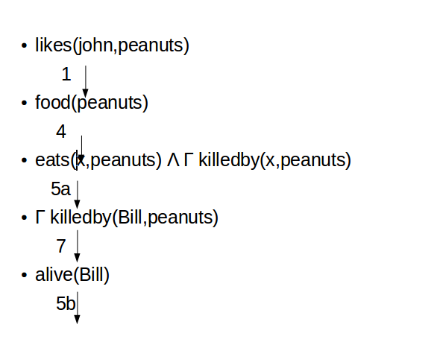
likes(john,peanuts)
1
food(peanuts)
4
eats(x,peanuts) Λ Г killedby(x,peanuts)
5a
Г killedby(Bill,peanuts)
7
alive(Bill)
5b

Slide 12
Lucky Student
1. Anyone passing his history exams and
winning the lottery is happy.
2. Anyone who studies or is lucky can pass all his exams.
3. John did not study but he is lucky.
4. Anyone who is lucky wins the lottery.
Prove that John is happy!

Slide 13
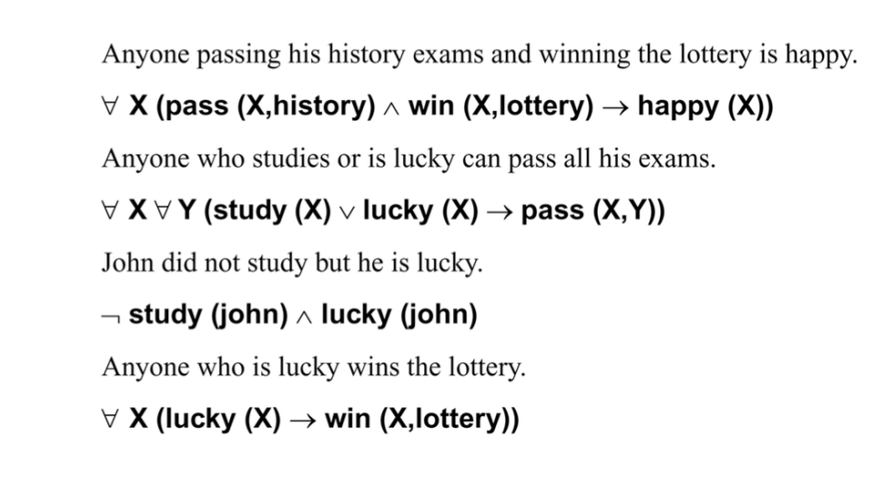

Slide 14
The law says that it is a crime for an American to sell weapons to hostile nations. The country Nono, an enemy of America, has some missiles, and all of its missiles were sold to it by Colonel West, who is American.
Prove that Col. West is a criminal!

Slide 15
1. Marcus was a man.
2. Marcus was a Pompeian.
3. All Pompeians were Romans.
4. Caesar was a ruler.
5. All Romans were either loyal to Caesar or hated him.
6. Everyone is loyal to someone.
7. People only try to assassinate rulers they are not loyal to.
8. Marcus tried to assassinate Caesar.

Slide 16
5. All Romans were either loyal to Caesar or hated him.
∀x: Roman(x) -> loyalto(x, Caesar) V hate(Caesar)
∀x: Roman(x) -> [(loyalto(x, Caesar) V hate(x, Caesar))∧
¬ (loyalto(x, Caesar) ∧hate(x, Caesar))]
6. Everyone is loyal to someone.
∀x:∃y : loyalto(x,y)

Slide 17
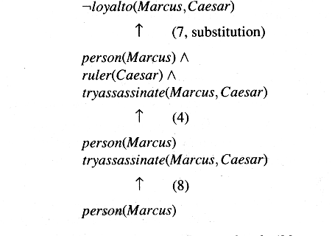

Slide 18
Computable predicates
While proving facts in predicate logic using backward or forward chaining, sometimes functions need to be computed to help in the proving process.
Gt(50,40) is a function to check whether 50 is greater than 40. It has to return the value “true”
Similarly less than, equal to etc.

Slide 19
Computable Predicates
To explain it better we once again return to example of Marcus:
1. Marcus was a man.
man(Marcus)
here once again the presence of past tense in the representation is not clear.
2. Marcus was a Pompeian.
Pompeian(Marcus)
3. Marcus was born in 40 A.D.
born(Marcus, 40)
For simplicity, we will not represent A.D. explicitly, just as we normally omit it in everyday discussions. If we ever need to represent dates B.C., then we will have to decide on a way to do that, such as by using negative numbers. Notice, that the representation of a sentence does not have to look like the sentence itself as long as there is a way to convert back and forth between them. This allows us to choose a representation, such as positive and negative numbers, that is easy for a program to work with.
4. All men are mortal.
∀x : man(x)→ mortal(x)

Slide 20
5. All Pompeians died when the volcano erupted in 79 A.D.
erupted(volcano, 79) ∧ ∀x : [Pompeian(x) → died(x, 79)]
This sentence clearly asserts the two facts represented above. It may also assert another that we have not shown, namely that the eruption of the volcano caused the death of the Pompeians. People often assume causality between concurrent events if such causality seems plausible.
Another problem that arises in interpreting this sentence is that of determining the referent of the phrase "the volcano." There is more than one volcano in the world. Clearly the one referred to here is Vesuvius, which is near Pompeii and erupted in 79 A.D. In general, resolving references such as these can require both a lot of reasoning and a lot of additional knowledge.
6. No mortal lives longer than 150 years.
∀x: ∀t₁ : ∀t₂ : mortal(x) ∧ born(x, t₁) ∧ gt(t₂-t₁,150) → dead(x, t₂)
There are several ways that the content of this sentence could be expressed. For example, we could introduce a function age and assert that its value is never greater than 150. The representation shown above is simpler, though, and it will suffice for this example.

Slide 21
7. It is now 1991.
now = 1991
Equal quantities that can be substituted for each other.
We now want to answer the question "Is Marcus alive?" There may be two ways of deducing an answer. Either we can show that Marcus is dead because he was killed by the volcano or we can show that he must be dead because he would otherwise be more than 150 years old, which we know is not possible. As soon as we attempt to follow either of those paths rigorously, however, we discover, just as we did in the last example, that we need some additional knowledge. So we add the following facts:
8. Alive means not dead.
∀x : ∀t : [alive(x, t) → ¬ dead(x, t)] ∧ [¬ dead(x, t)→ alive(x, t)]
This is not strictly correct, since ¬dead implies alive only for animate objects. (Chairs can be neither dead nor alive.) Again, we will ignore this for now.
9. If someone dies, then he is dead at all later times.
∀x : ∀t₁ : ∀t₂ : died(x, t₁) ∧ gt(t₂,t₁)→ dead(x, t₂)
This representation says that one is dead in all years after the one in which one died. It ignores the question of whether one is dead in the year in which one died.

Slide 22
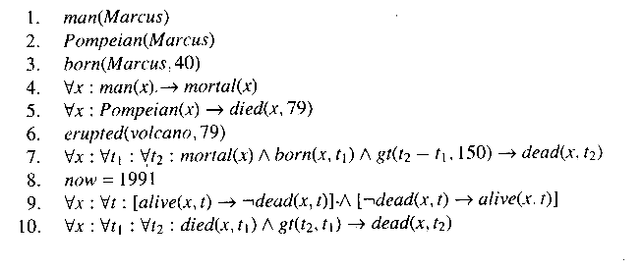
A Set of Facts about Marcus
Notice in those proofs that whenever a statement of the form:
a ∧ b → c
was used, a and b were set up as independent subgoals. In one sense they are, but in another sense they are not if they share the same bound variables, since, in that case, consistent substitutions must be made in each of them.

Slide 23
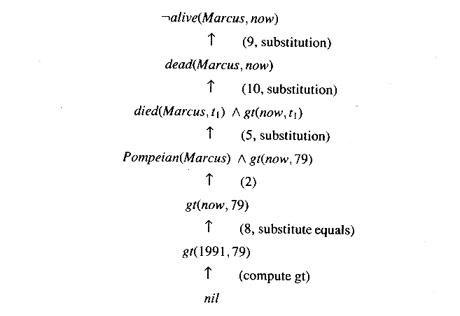
One Way of Proving That Marcus Is Dead

Slide 24
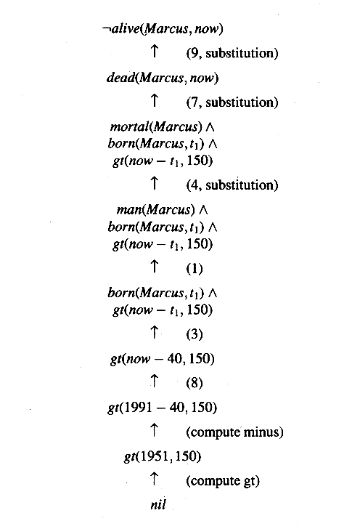
Another Way of Proving That Marcus Is Dead

